Slide 1
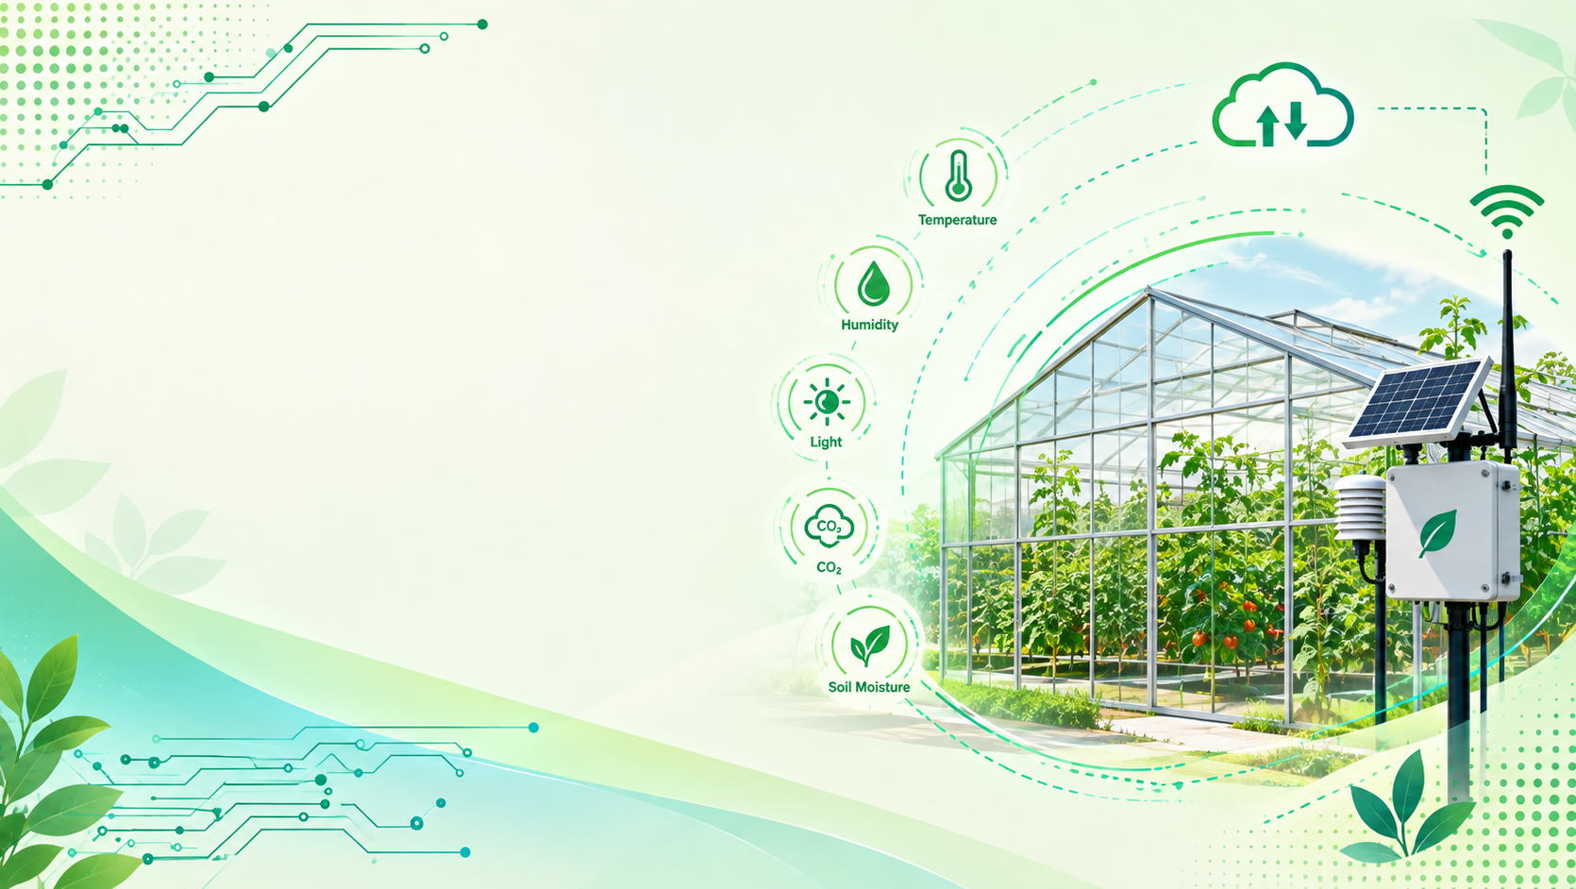
Smart Greenhouse Monitoring System
To develop an IoT-based Smart Greenhouse using ESP32 that automatically monitors and controls soil moisture, temperature, humidity, lighting, irrigation, ventilation, and rain protection, while allowing real-time monitoring and manual control through the Blynk mobile app.
Automatic-Control
Manual-Control
Wifi
Real-Time monitoring
CSE 3118 - Microprocessors & MicroControllers Lab
Submitted by:
Ahona Zabin(30)
Fahmida Afrin Nadia(47)
Afifa Faija(114),
Afra Anan(117)
Ahsanullah University of Science and Technology

Slide 2
Project Overview
What we are building?
A compact IoT-based Smart Greenhouse that combines automatic environmental monitoring, plant-care automation, and user control.
CORE IDEA
The system continuously monitors greenhouse conditions and automatically controls irrigation, ventilation, lighting, and roof protection based on sensor data, while allowing users to monitor and control the greenhouse remotely.
Environmental Monitoring
Soil moisture • Temperature • Humidity • Light intensity • Rain detection
Automatic Control
Smart irrigation • Water pump control • Automatic fan control • LDR-based light control • Automatic roof control
User Control
Blynk IoT • Mobile app monitoring • Manual control • Automatic control
Control System
ESP32 • Sensors • Servo motor
• Real-time monitoring

Slide 3
System Features
Core features
Main functions of the Smart Greenhouse System.
01 Soil Moisture Monitoring
Soil moisture sensor checks the soil condition and detects when irrigation is needed.
02 Automatic Irrigation
Water pump automatically turns ON/OFF based on soil moisture level.
03 Temperature & Humidity Control
Sensors monitor temperature and humidity, while the fan automatically operates when required.
04 Automatic Light Control
LDR sensor detects light intensity and automatically controls the greenhouse lighting.
05 Rain-Based Roof Control
Rain sensor detects rainfall and servo motor automatically opens or closes the greenhouse roof.
06 Blynk IoT Monitoring
Mobile app displays real-time sensor data and greenhouse status.
07 Manual & Automatic Control
Users can switch between automatic operation and manual control through the mobile app.

Slide 4
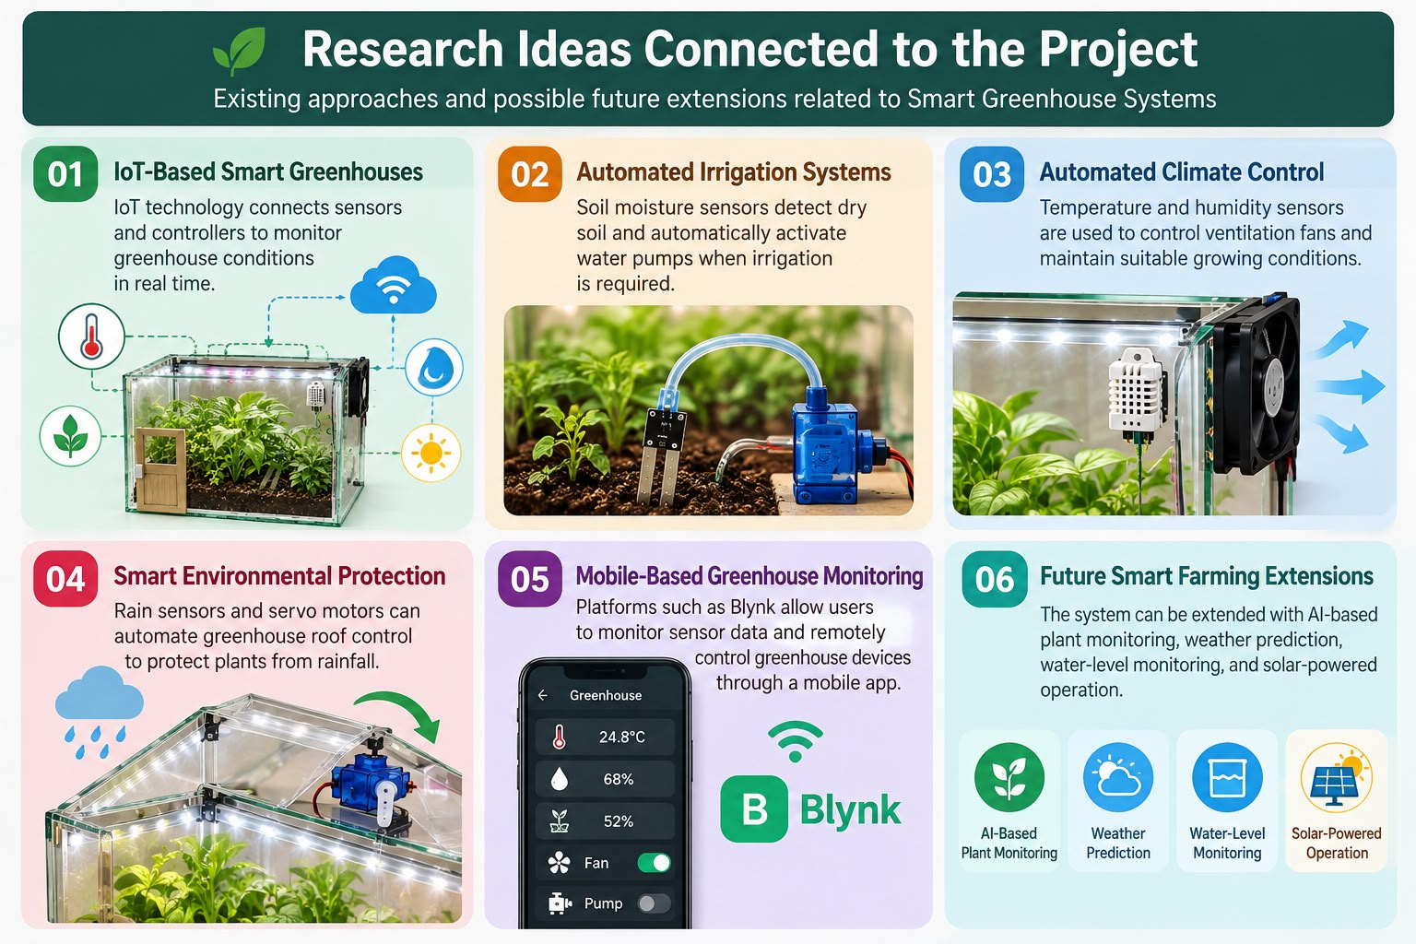
Related Works

Slide 5
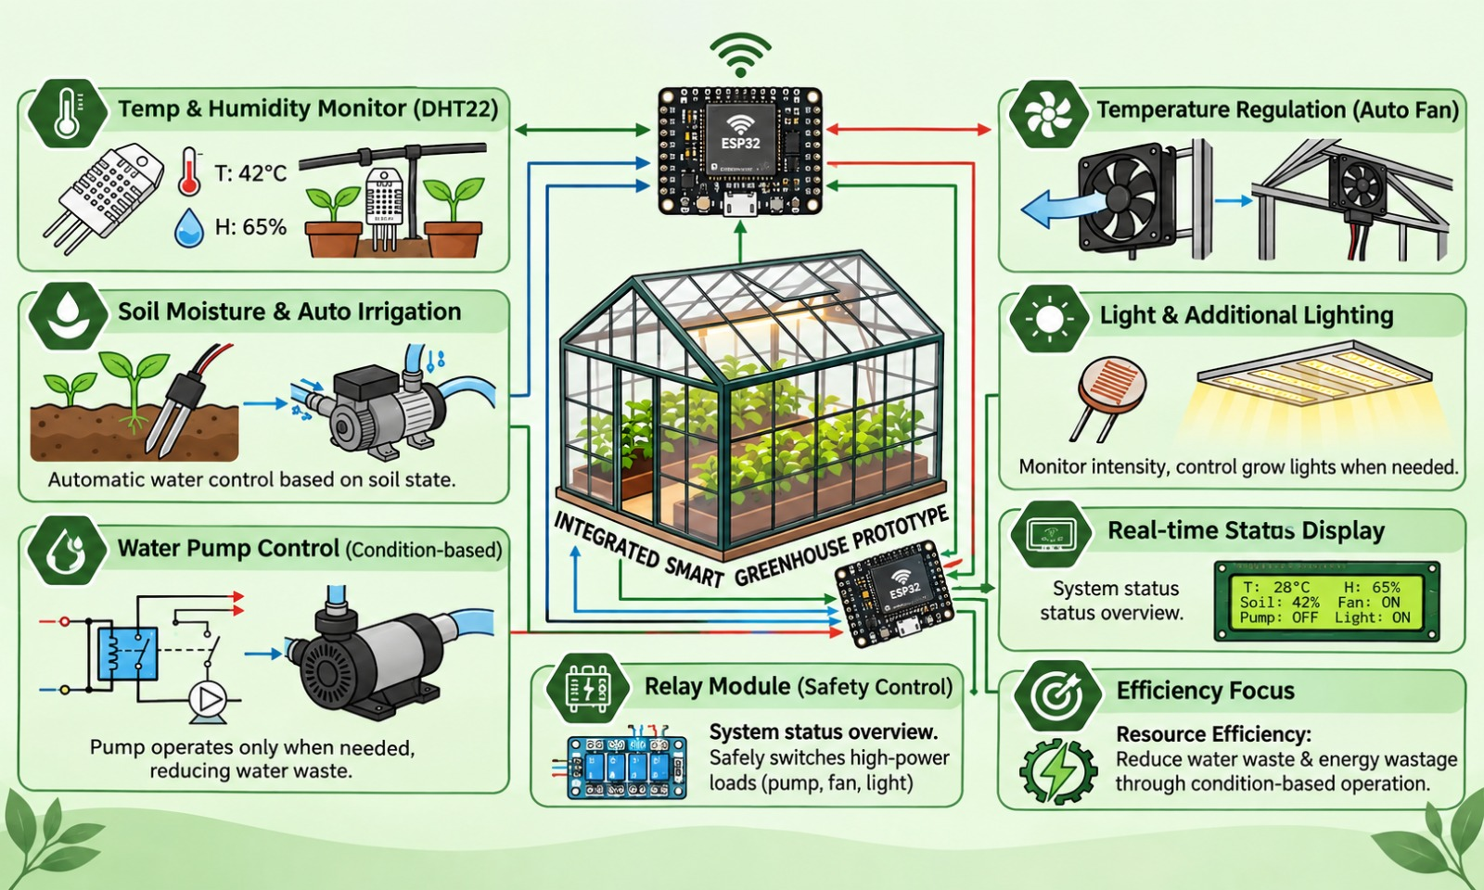
Objective

Slide 6
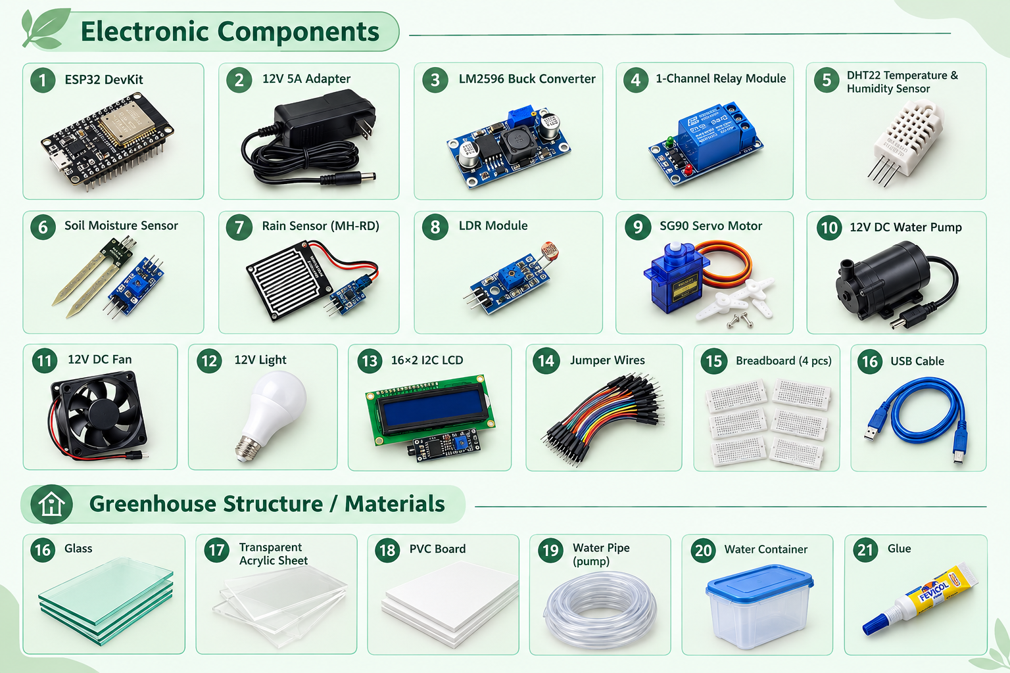
List of Tools

Slide 7
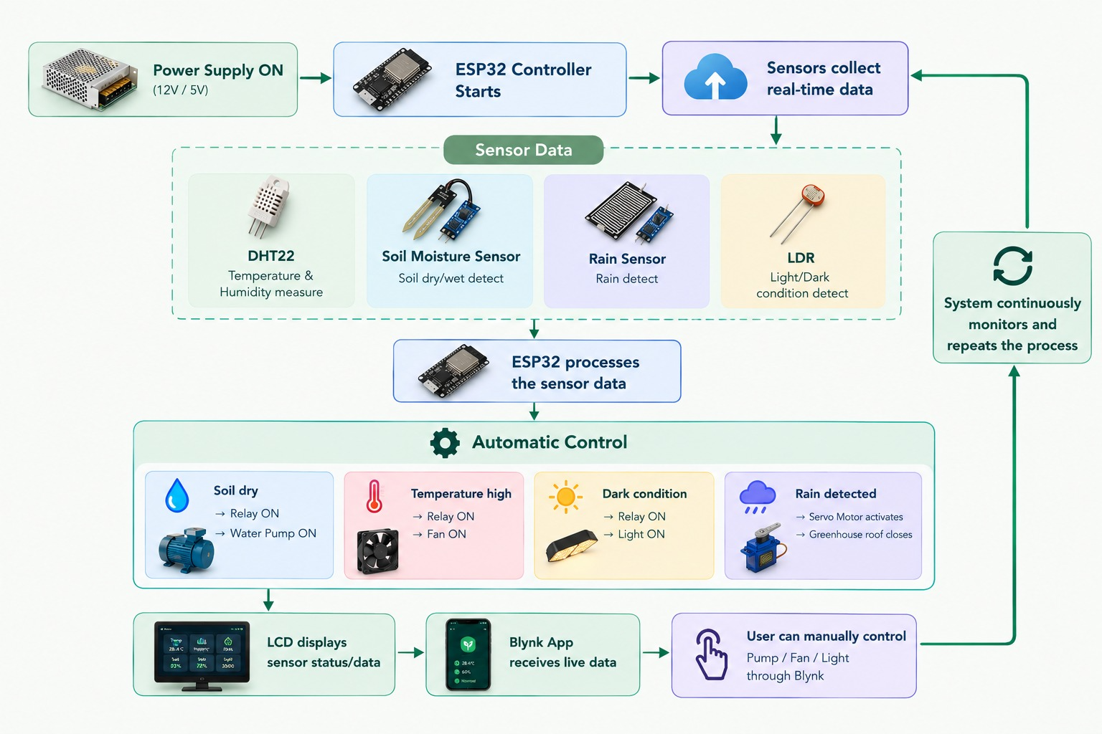
Control Flow

Slide 8
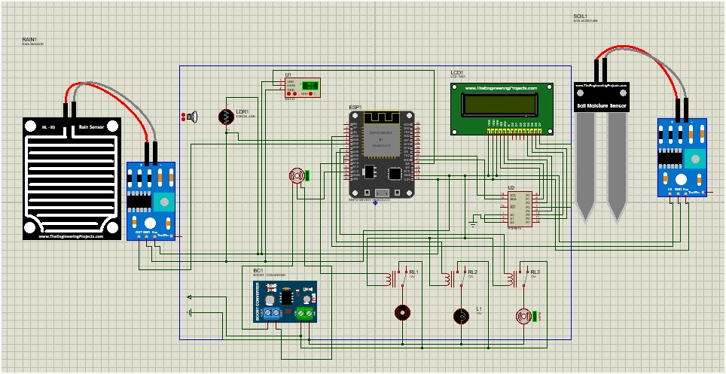
Proteus Diagram

Slide 9
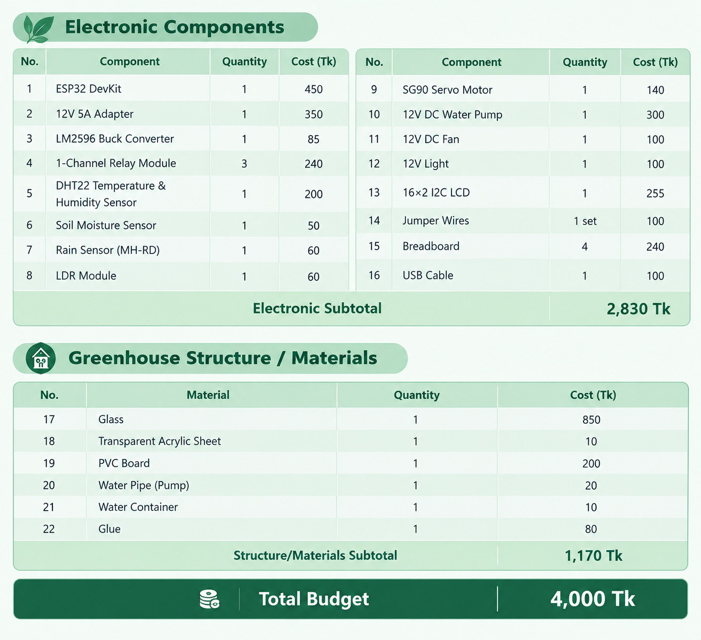
Budget Analysis

Slide 10
Sustainability
Modular Design
Cost Efficiency
Scalability
Water Efficiency
Energy Efficiency
Future Scope

Slide 11
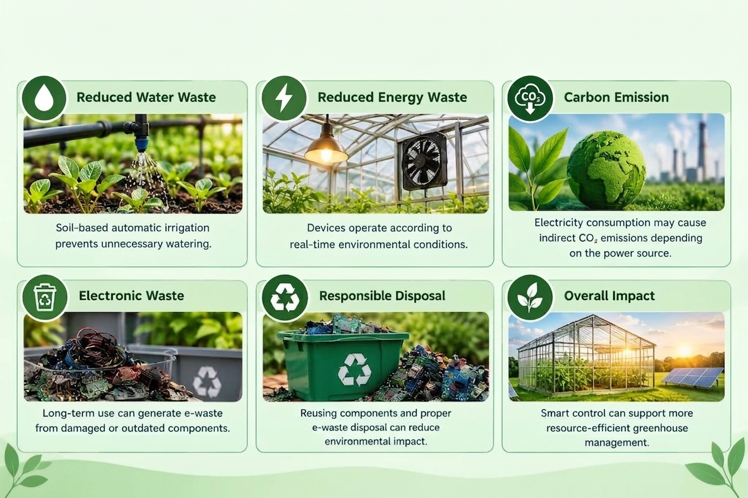
Environmental Impact

Slide 12
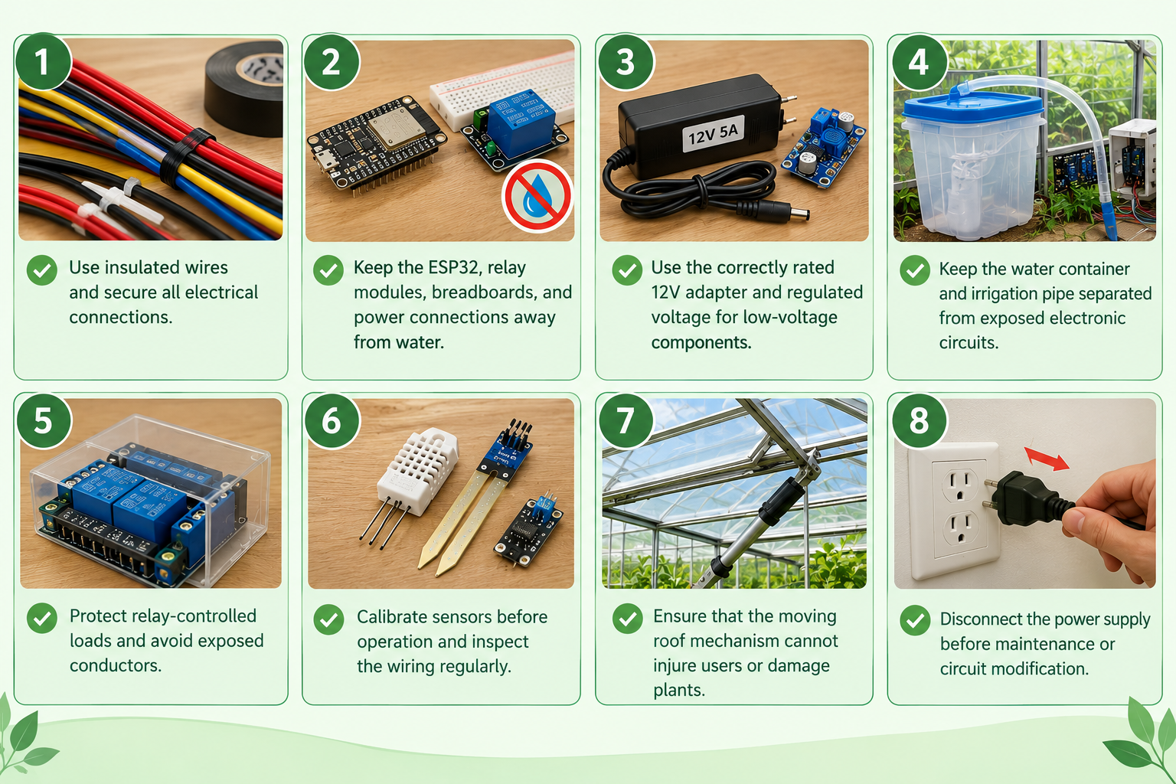
SAFETY NORMS AND COMPLIANCE MEASURE

Slide 13
STAKEHOLDERS & ISSUES
Farmers & Greenhouse Owners
automated and efficient greenhouse management
Agricultural Researchers
testing smart-farming techniques
Students & Universities
practical learning of IoT, sensors & automation
Technology Developers
foundation for smart-agriculture solutions
Government & Environmental Organizations
potential use in sustainable agriculture

Slide 14
CONCLUSION
ESP32-based smart greenhouse successfully integrates sensors and actuators.
Monitors temperature, humidity, soil moisture, light & rainfall in real time.
Automatically controls water pump, fan, light & greenhouse roof.
Supports LCD display and Blynk-based monitoring/control.
Affordable implementation cost: BDT 4,000
Provides a foundation for IoT monitoring, renewable energy & larger-scale smart farming.
“Smart, Affordable & Expandable Solution for Modern Agriculture.”

Slide 15
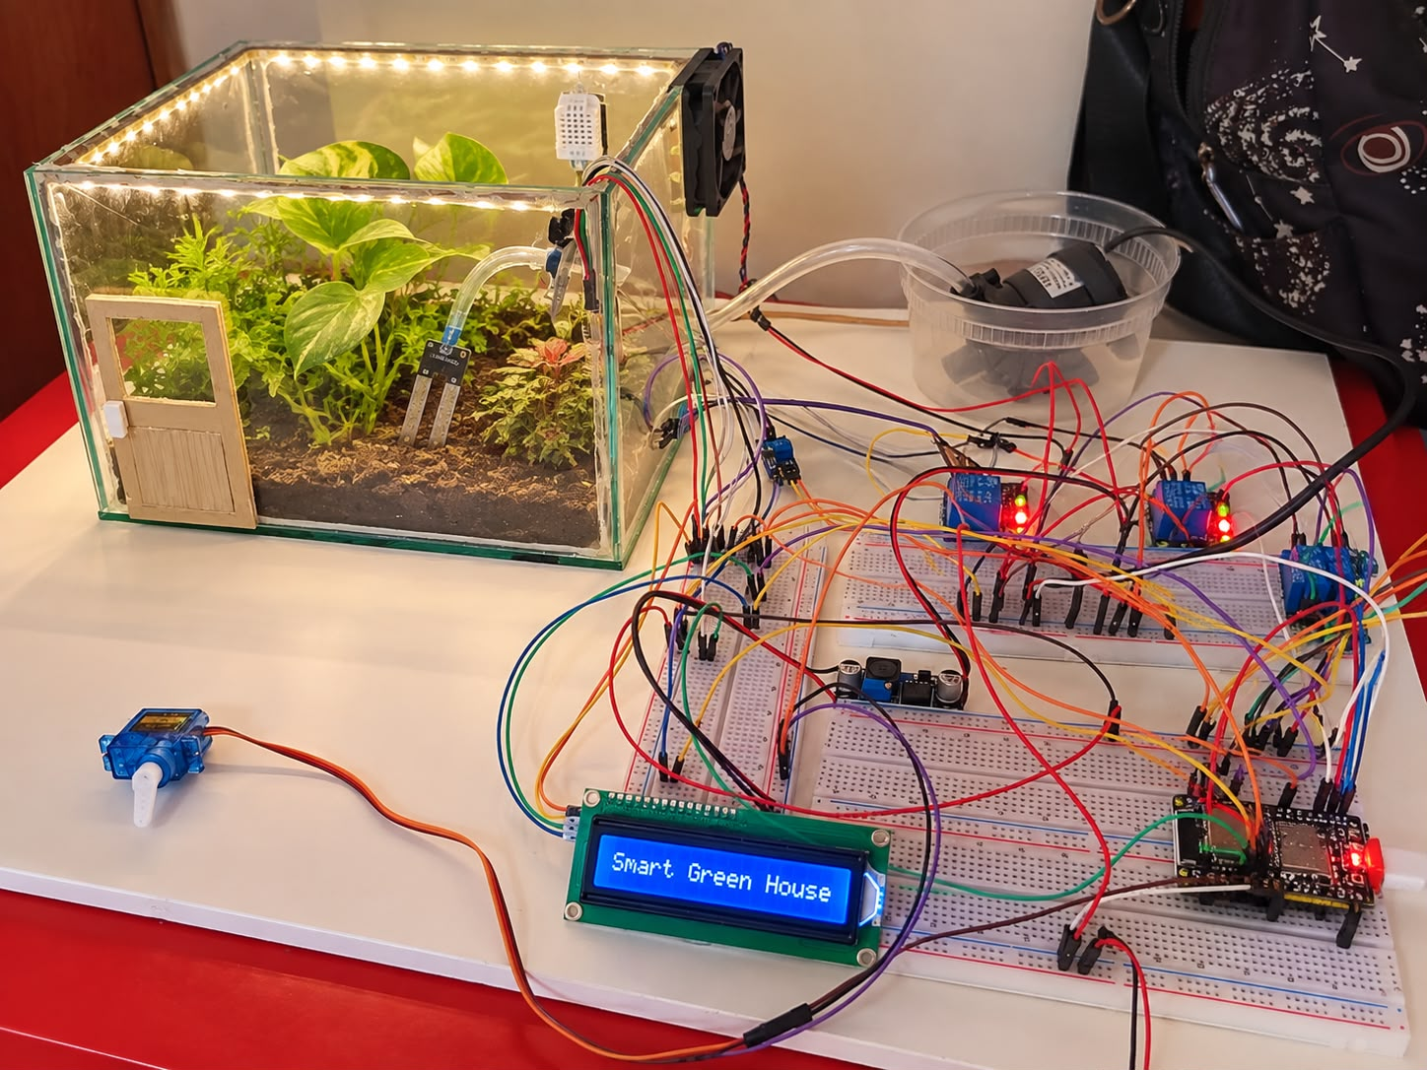
Smart Greenhouse Monitoring System

Slide 16
Thank You

